Slide 1
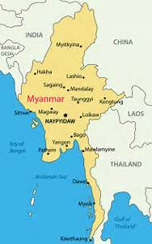
Maintenance of Civil Registration and Vital Statistics Components
Myanmar
Mr. Myint Naing
Director
General Administration Department
Myanmar
Notes:
High level key officials, distinguish colleagues, lady and gentle men a good day to you all.
I am honor to present on the ‘Maintenance of Civil Registration and Vital Statistics Components.

Slide 2
Requirements for maintaining effective and reliable
Civil Registration and Vital Statistics Systems
a good and solid foundation
Notes:
Requirements for maintaining effective and reliable of Civil Registration and Vital Statistics Systems is to have a good and solid foundation

Slide 3
Outlines
Modification of records
Internal review
Preservation of stored records
Field operations
Notes:
My presentation will cover four key points:
Modification of records
Internal review
Preservation of stored records
Field operations

Slide 4

Modification of records
Birth and death registration was initiated during the colonial period;
13 different forms were used until 2000;
System was modified in 2001 and number of forms were reduced to 8;
Statistical and Health department collaborated for registration and issuing certificate;
Notes:
Birth and death registration was initiated during the colonial period. We have used 13 different forms until 2000. They system was modified in 2001 and number of forms were reduced to 8;

Slide 5

Internal review
,
CRVS has been managed by four entities;
In 2006, Inter-Agency Working Group was formed/chaired by DG for CSO;
In 2014, Coordination Committee for Birth and Death was formed/chaired by Minister for Health;
Notes:
In Myanmar CRVS has been managed by four entities. Which are Statistical Office, Health Office, Immigration and General Administration (my office)
Since there is no focal department or ministry, in 2006, Inter-Agency Working Group was formed, which was chaired by DG for CSO with the involvement of member from concerned departments; This body focus on technical as well as implementation with the guidance provided by Coordination Committee for Birth and Death which is formed in 2014 chaired by Minister for Health with the involvement of member from concerned ministries.

Slide 6

Key actions (based on internal review)
,
Birth registration campaign;
Development of the Birth and Death Registration Manual
Establishment of VR E-Platform;
Notes:
With the systematic collaboration, internal review, Myanmar managed to work on conducting:
- Birth registration campaign;
- Development of the Birth and Death Registration Manual
- Establishment of VR E-Platform;

Slide 7

Key actions (based on internal review)
Birth Registration Campaign
Notes:
This is the poster we used for birth registration campaign.

Slide 8
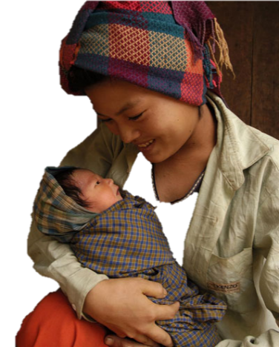
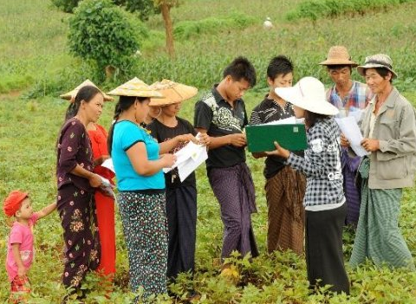


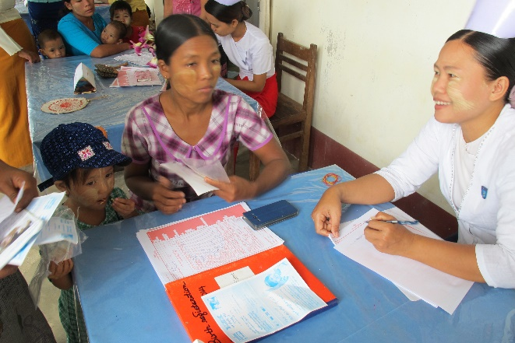
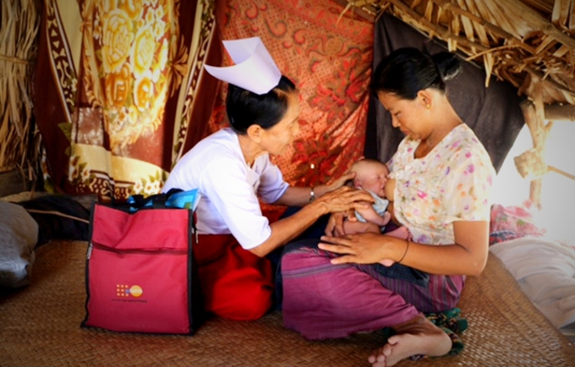
300,000 U5 children were registered
Key actions (based on internal review)
Pre
During
Notes:
The 5-day campaign in six states/regions reaches more than 300,000 under five children, because the campaign was conducted in very systematic manner with its preparation work
To announce using poster, invitation cards, T-shirts and transit media.
Registration posts were opened at the community areas for easy access.
Mobile registration was done for the hard to reach community.

Slide 9

Key actions (based on internal review)
Notes:
This the pamphlet that we used during the campaign.

Slide 10

Key actions (based on internal review)

Slide 11
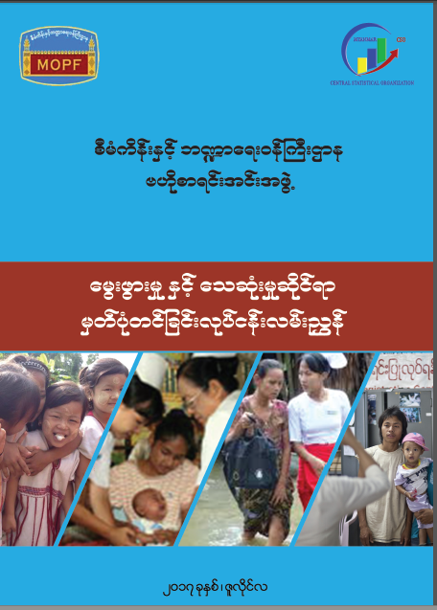

Key actions (based on internal review)
Birth and Death Registration Manual
Principle of
Universal Birth Registration
Notes:
In the absence of CRVS law, the Birth and Death Registration Manual is only document for implementers to refer to.
This manual indicates all key principles on Universal Birth Registration with focus made on ‘leaving no one behind’.

Slide 12
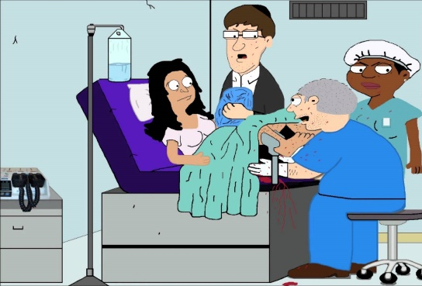



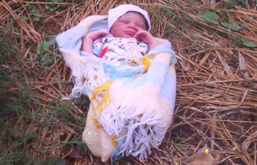
Registration of birth must be reported by
A person present at delivery (including the service provider)
All under 10 children born within Myanmar must be registered at timely manner
A caretaker
Father
Mother
A person living in same house or building
A person who saw the neglected baby (if <18yr – must report through local authority)
Birth Registration is free of charge
Notes:
With this new manual Myanmar will be registering
All under 10 children born within Myanmar must be registered at timely manner at free of charge.
It also mention for returnees and migrant population and neglected baby.

Slide 13
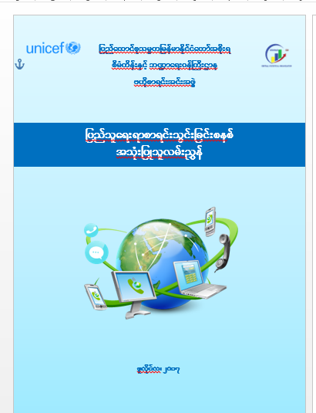
Key actions (based on internal review)
Vital Registration E-Platform
Notes:
Myanmar registration system is 100% paper-based and for the first time in Myanmar which was in 2014, the Vital Registration E-platform was introduced.

Slide 14
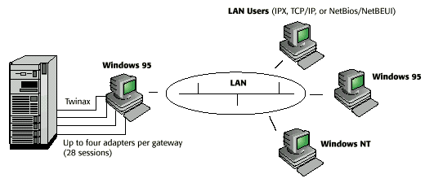
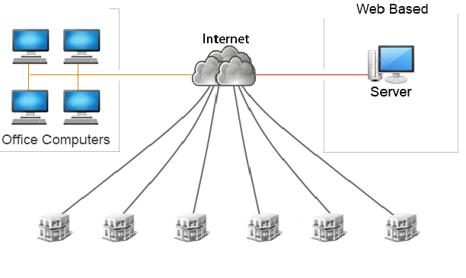
Key actions (based on internal review)
Establishment of VR E-Platform
Administrator
Service Provider
CSO/Union
Open Source
MCIT
State/Region
District
Operaator
Township
Notes:
This is how it look like and we are using open source solution.

Slide 15
Preservation of stored records
VR E-Platform was established in late 2014;
Currently linking all State/Region statistics offices with union level;
Scale-up of E-platform is in progress to replace the paper-based with digital archive;
Notes:
So this VR E-Platform was established in late 2014;
Currently linking all State/Region statistics offices with union level;
Scale-up of E-platform is in progress to replace the paper-based with digital archive (scale up plan is under discussion)

Slide 16
Field operations
CRVS has been managed by four entities in Myanmar
General Administration is one out of four entities supporting VR registration;
Only department has presence at lowest community/village;
Built strong collaboration with mid-wife to make sure all vital events are recorded;
Notes:
General Administration is one of out four entities supporting VR registration. We have staff at lowest community/village in order to reach all or more people.
We have built strong collaboration with mid-wife to make sure all vital events are recorded at timely manner.

Slide 17

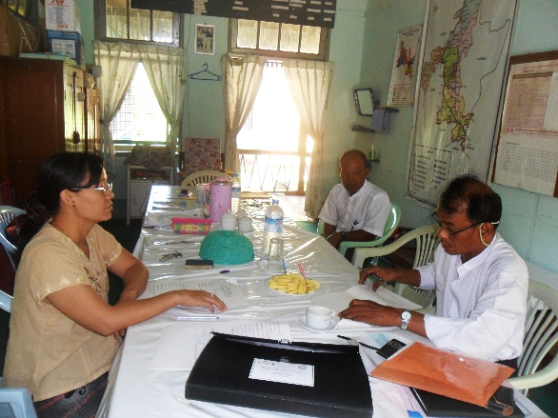
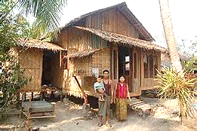
Field operations - structure
National & Sub-national
Registration
Statistical Officer
Township Level
Issuing certificate
Medical officer
Village Level
Data collection
GA+MW
Notes:
This is how we collaborate with departments. It is not here but Immigration Department work with us closely on household listing.

Slide 18

Thank you for your attention
Notes:
Thank you very for your attention.

